Slide 1

Future Location Prediction System
SATISH NAGAR
DATA SCIENCE INTERN
AT HACKVEDA

Slide 2

OUTLINES:
Why We Need It (Hook Story)
Introduction
Objective of the Project
Importance of the Project
Data Source
Dataset Description
Dataiku DSS Setup
Demonstration Part
Data Cleaning
Target
Train
Metrics
Algorithm
Feature Handling
Hyperparameter Tuning
Start Training
Project Snapshot
Conclusion
References
Contact

Slide 3

Why We Need It (Hook Story)
Priya, a nurse, works at a busy hospital where quick transportation of critical patients. One day, the hospital needed to send an ambulance urgently for a critical patient. However, the main route was jammed with traffic, and every second counted.
Fortunately, Priya’s phone had an app connected to the hospital’s fleet management system, which integrated real-time traffic data. The system analyzed traffic conditions and sent a push notification to Priya, suggesting an alternative route that would save valuable time.

Slide 4

Why We Need It (Hook Story)
The Notification Read: "Alert: Traffic on your current route is heavy. Suggested alternate route will save you 10 minutes. Please follow the new route."
Priya immediately followed the new suggested route, and the ambulance reached the hospital on time, saving the patient’s life.
This system worked by using real-time traffic data, GPS coordinates, and predictive models to suggest the fastest route. By using this location prediction system, emergency services can respond faster, saving lives and ensuring timely delivery.

Slide 5

Introduction
The Future Location Prediction System uses predictive analytics and machine learning to forecast the future location of an object or person based on past movement data. By integrating real-time traffic information and GPS data, it helps optimize routes, ensuring timely arrivals and more efficient transportation. In scenarios like emergency medical services, this system can save lives by suggesting faster routes, avoiding traffic jams, and improving response times.

Slide 6

Objective of the Project
To develop a system that predicts the fastest route using past movement data and real-time traffic information. The system aims to optimize emergency services, deliveries, and personal travel.
The goal is to minimize delays, optimize travel time, and improve safety.

Slide 7
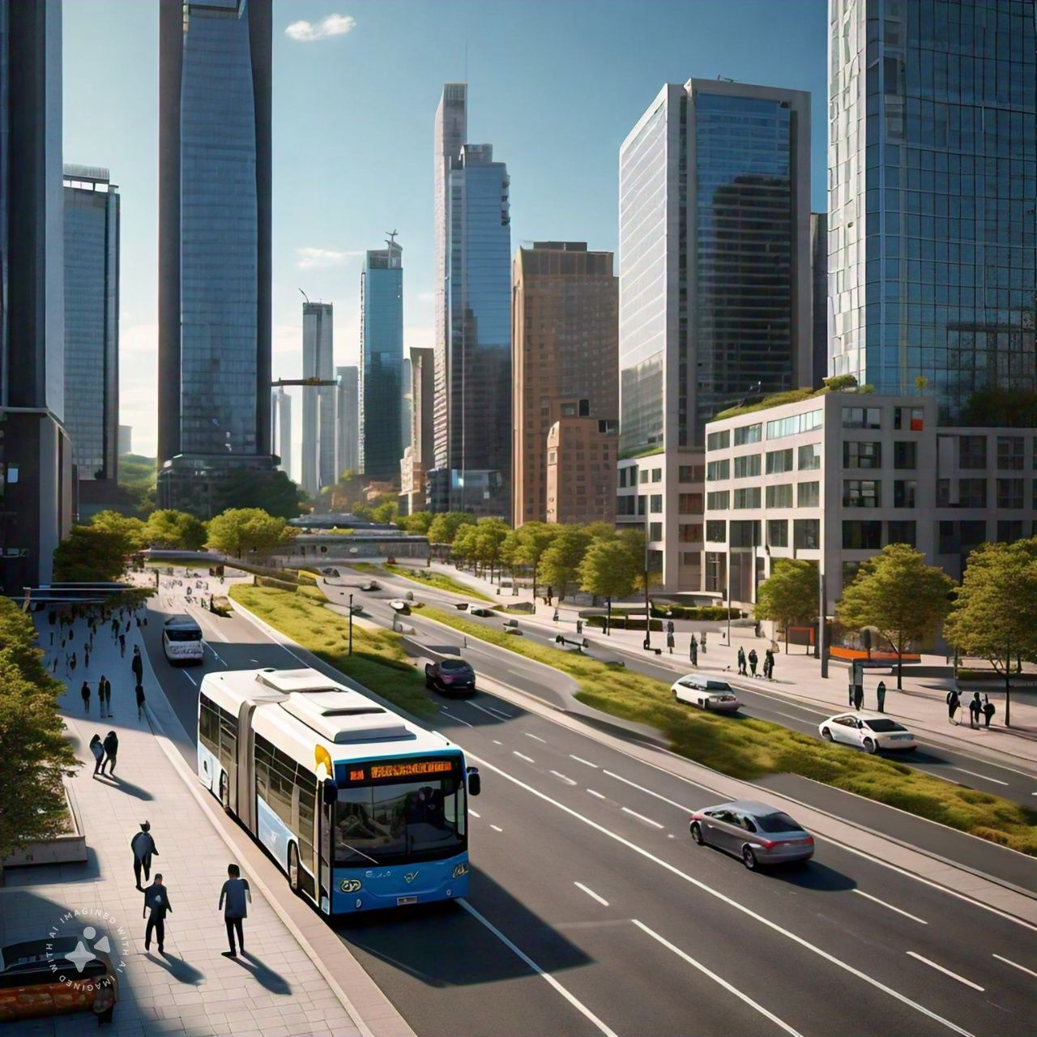


Importance of the Project
This project improves emergency response time, reduces traffic congestion, saves lives, and increases efficiency in transportation and logistics, ultimately contributing to smarter city management.

Slide 8

Data Source
The data comes from Hackveda in CSV format, containing historical movement data (start and end locations with timestamps), used for training the prediction model.

Slide 9
Dataset Description
The dataset consists of the following columns:
ID: Unique identifier for each movement.
eventTimeStart: Start time of the event.
eventTimeEnd: End time of the event.
latStart: Starting latitude.
lonStart: Starting longitude.
latEnd: Ending latitude (target for prediction).

Slide 10

Dataiku DSS Setup
Dataiku DSS is a platform for data science and machine learning that helps manage datasets, clean data, build models, and deploy solutions.
In this project, we used Dataiku to set up the environment, load the dataset, and perform data preprocessing and model training.

Slide 11

Demonstration Part
Demonstration refers to the practical application and walkthrough of the steps taken to build, train, and evaluate the Future Location Prediction System.
It involves showing how the data is processed, cleaned, and used to train a machine learning model, followed by testing its accuracy and performance.

Slide 12

Data Cleaning
Data Cleaning in Dataiku for this project involves preparing the dataset by:
Removing or handling missing values (nulls).
Correcting invalid or inconsistent data (e.g., incorrect locations).
Ensuring data consistency (e.g., proper formatting).

Slide 13
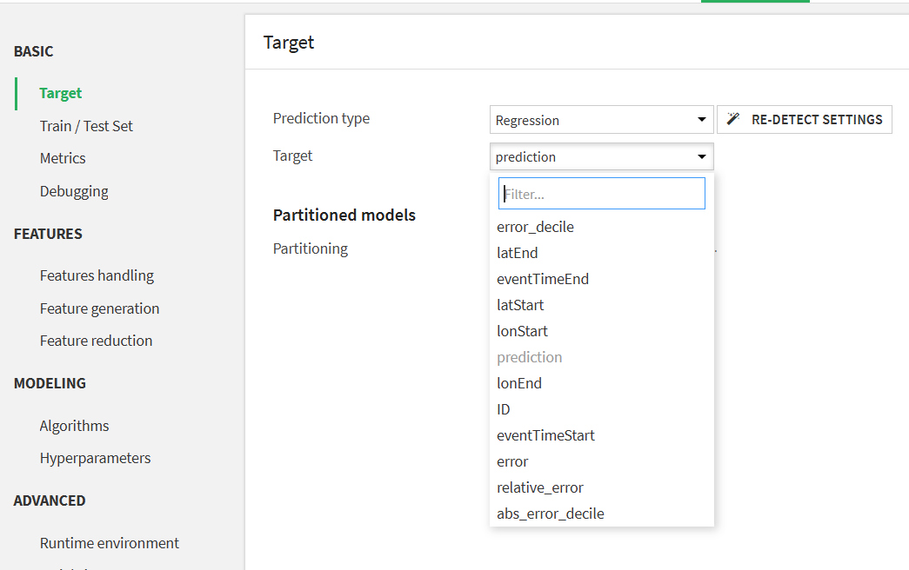
Target
The goal of the model is to predict latEnd (the ending latitude of a location), which helps determine the next location in a series of movements.

Slide 14
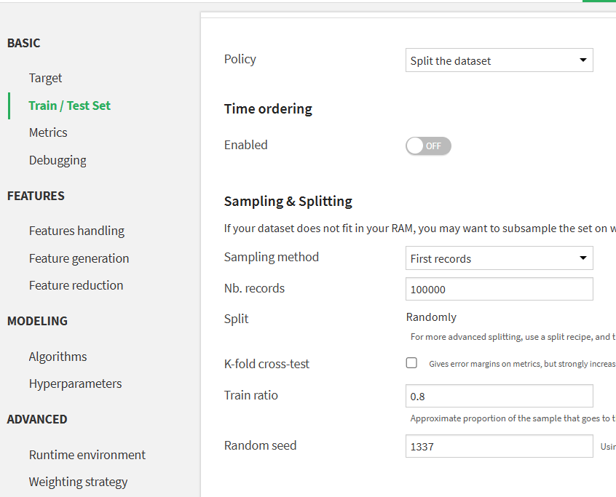
Train
In test set Split the Dataset
80% of training Ratio and train speed is 20.
This allows us to test how well the model generalizes to new, unseen data.

Slide 15
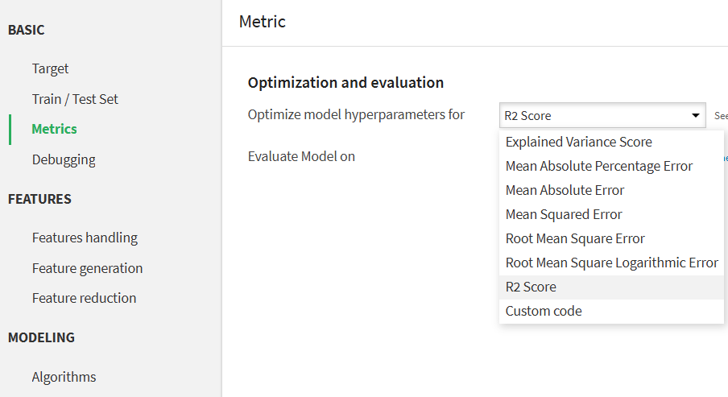
Metrics
We use the R² score to measure the model’s accuracy

Slide 16
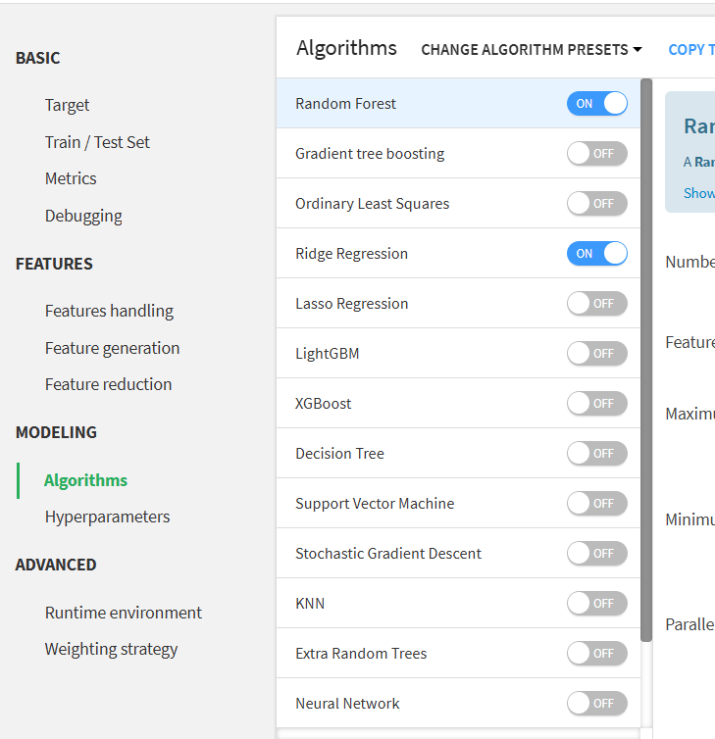
Algorithm
The algorithm cleans the data, selects features, splits it into training and validation sets, trains a model, tunes it with Grid Search, evaluates accuracy with the R² score, and predicts **latEnd** for new data.

Slide 17
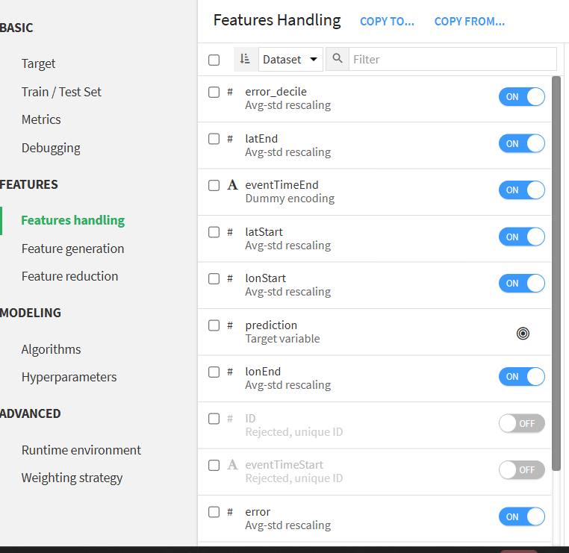
Feature Handling
The model focuses on latEnd as the target variable to predict the next location. Features like latStart, lonStart, eventTimeStart, etc., are used as inputs to the model to predict latEnd.
Change as per need!!

Slide 18
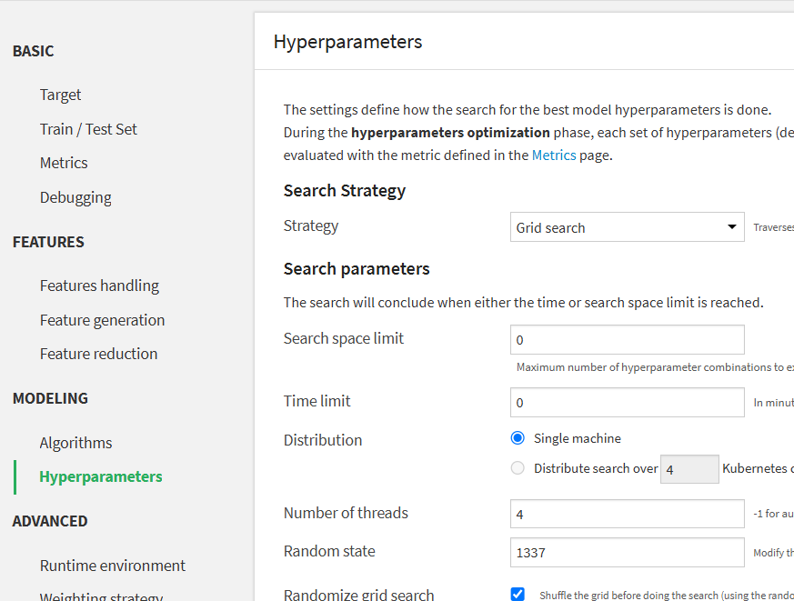
Hyperparameter Tuning
Hyperparameter tuning is done using the Grid Search technique or Strategy.
Which involves testing multiple combinations of hyperparameters to find the best-performing model configuration.

Slide 19
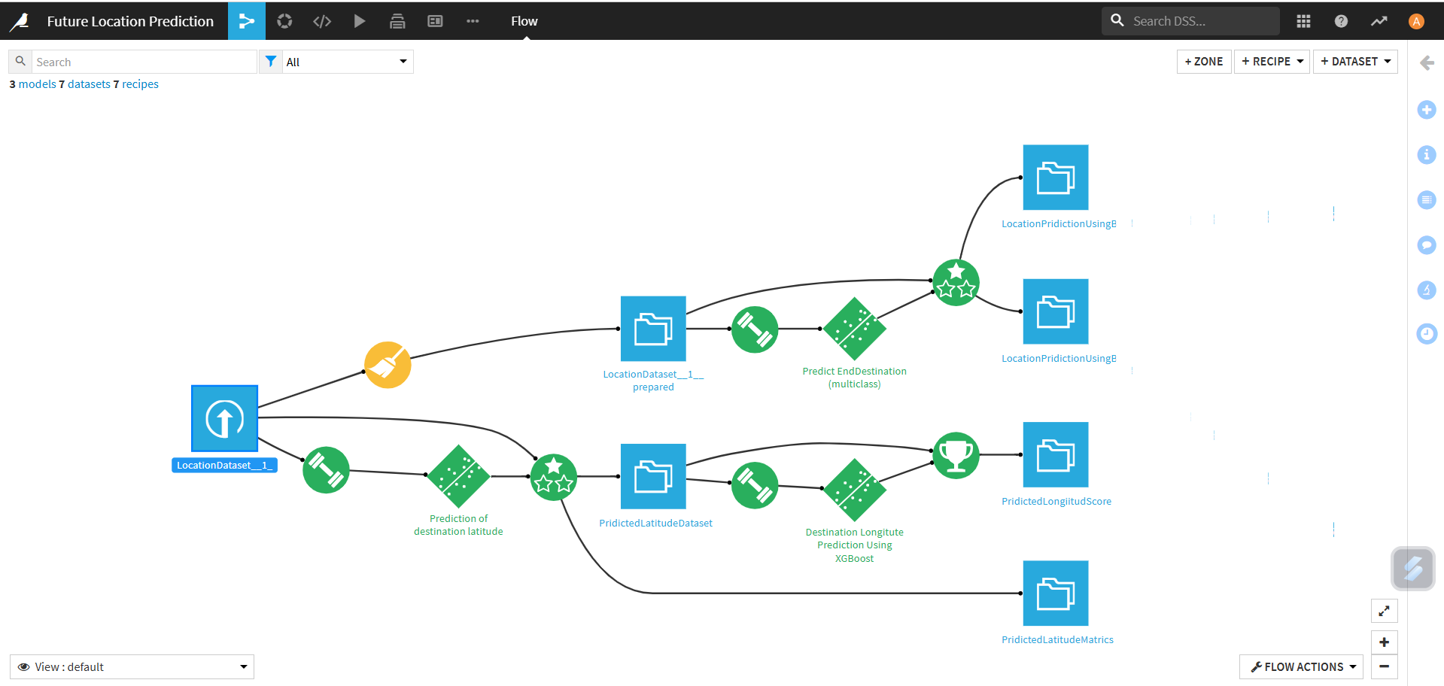
Project Snapshot

Slide 20

Conclusion
The Future Location Prediction System predicts future positions using past location data, enabling smarter travel decisions. By applying machine learning and data processing, it helps improve traffic management, optimize routes for businesses, and enhance emergency services. This project demonstrates the real-world benefits of predictive models, with potential for future advancements. As the model evolves, it can revolutionize transportation and urban planning, leading to more efficient, smarter cities.

Slide 21




References
ChatGPT
YouTube
Hackveda
Google

Slide 22




Contact
For any queries,
feel free to reach out at
satishnagar248@gmail.com
www.linkedin.com/in/satish-nagar-nilu

Slide 23
Thank-you ☺

